Slide 1





Eye-tracking SYSTEM for Diagnosis of Visual Deficits
Sidhant raje
Jerry Zhang
Supervisor: Dr Luke hallum
Part IV Project 2019

Slide 2
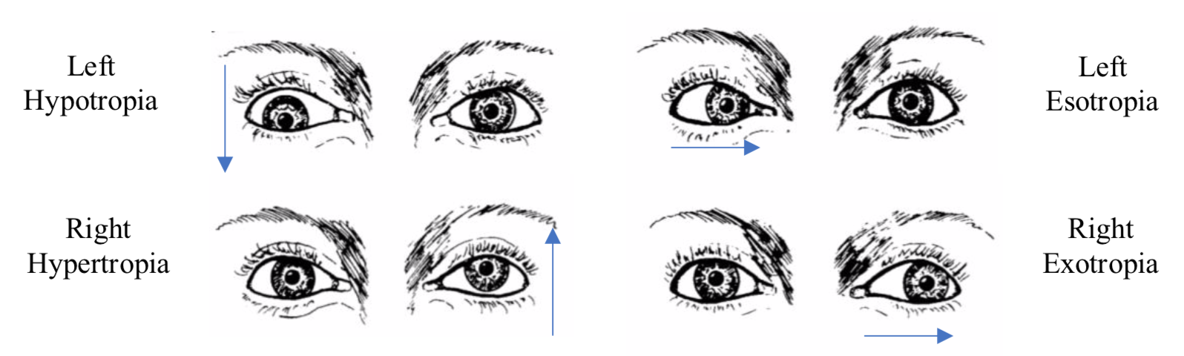
Introduction
Visual deficits in children require prompt attention; if left untreated a deficit may cause permanent, irreversible vision loss.
Strabismus is a disorder involving misalignment of the eye’s visual axes which can result in vision loss.
Subjectivity in the manual diagnosis of this deficit may lead to low sensitivity.
Four main types of strabismus
Notes:
- High prevalence in children, affecting approximately millions of children worldwide.
- Caused by disorder in the coordination of extraocular muscles or failure to align the visual axes after birth.

Slide 3
Introduction
Our research focuses on the development of a more objective examination for strabismus.
The development of eye-tracking technology has accelerated in recent years, which presents new opportunities for diagnostic devices.
We aim to design, build and implement a computer-based test that enables the use of eye-tracking in detecting strabismus, and quantifying its severity.

Slide 4
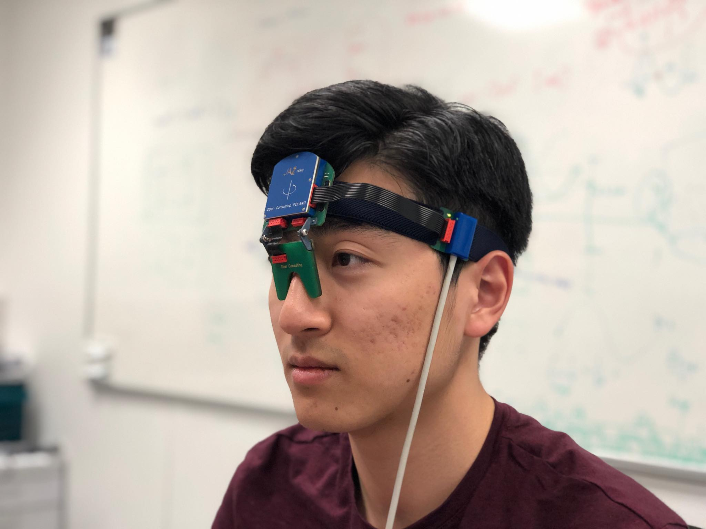
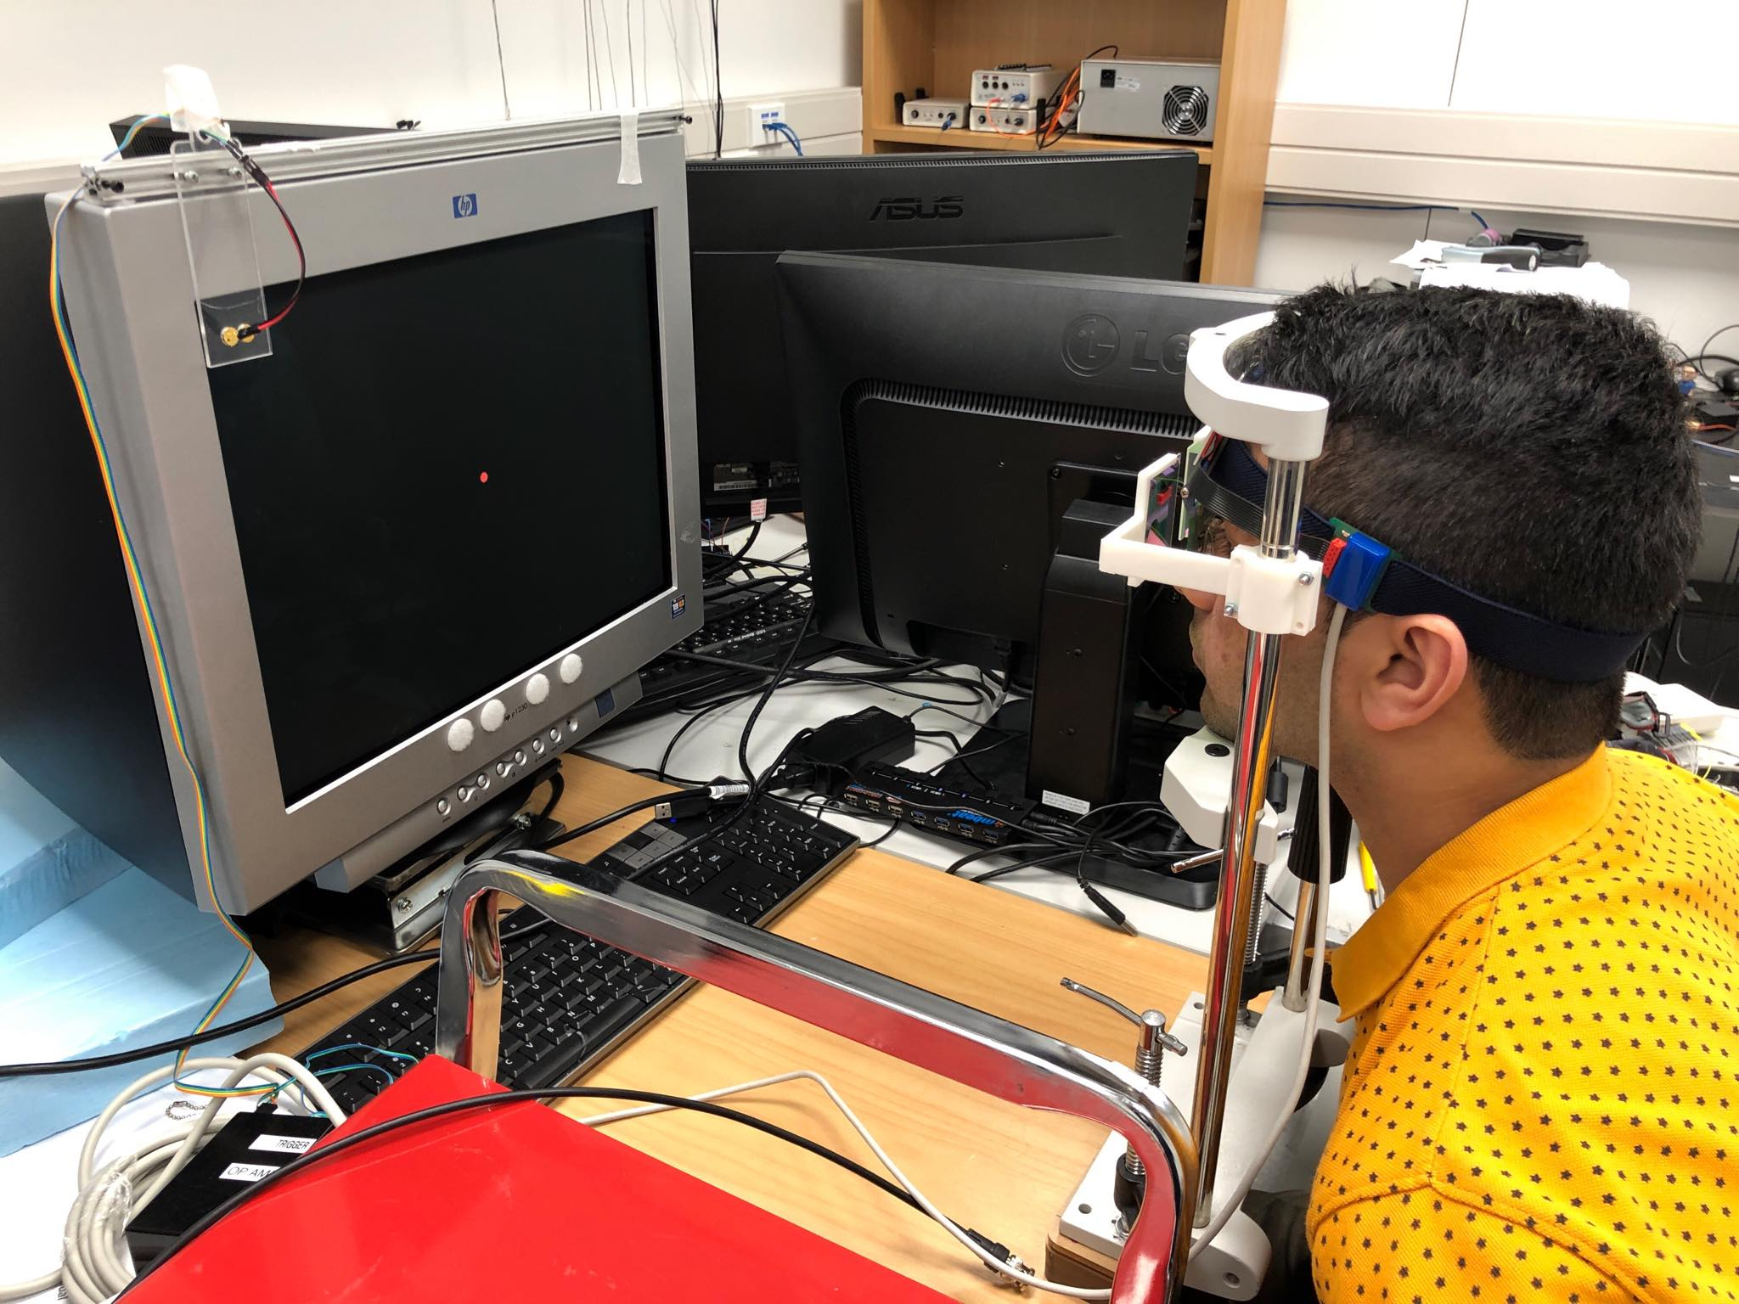
method
Jazz-novo Eye-tracker
Eyes are illuminated with infrared light
Reflected light can be used to determine eye movements
Outputs resultant gaze position in horizontal and vertical directions
Sampling frequency of 1 kHz

Slide 5
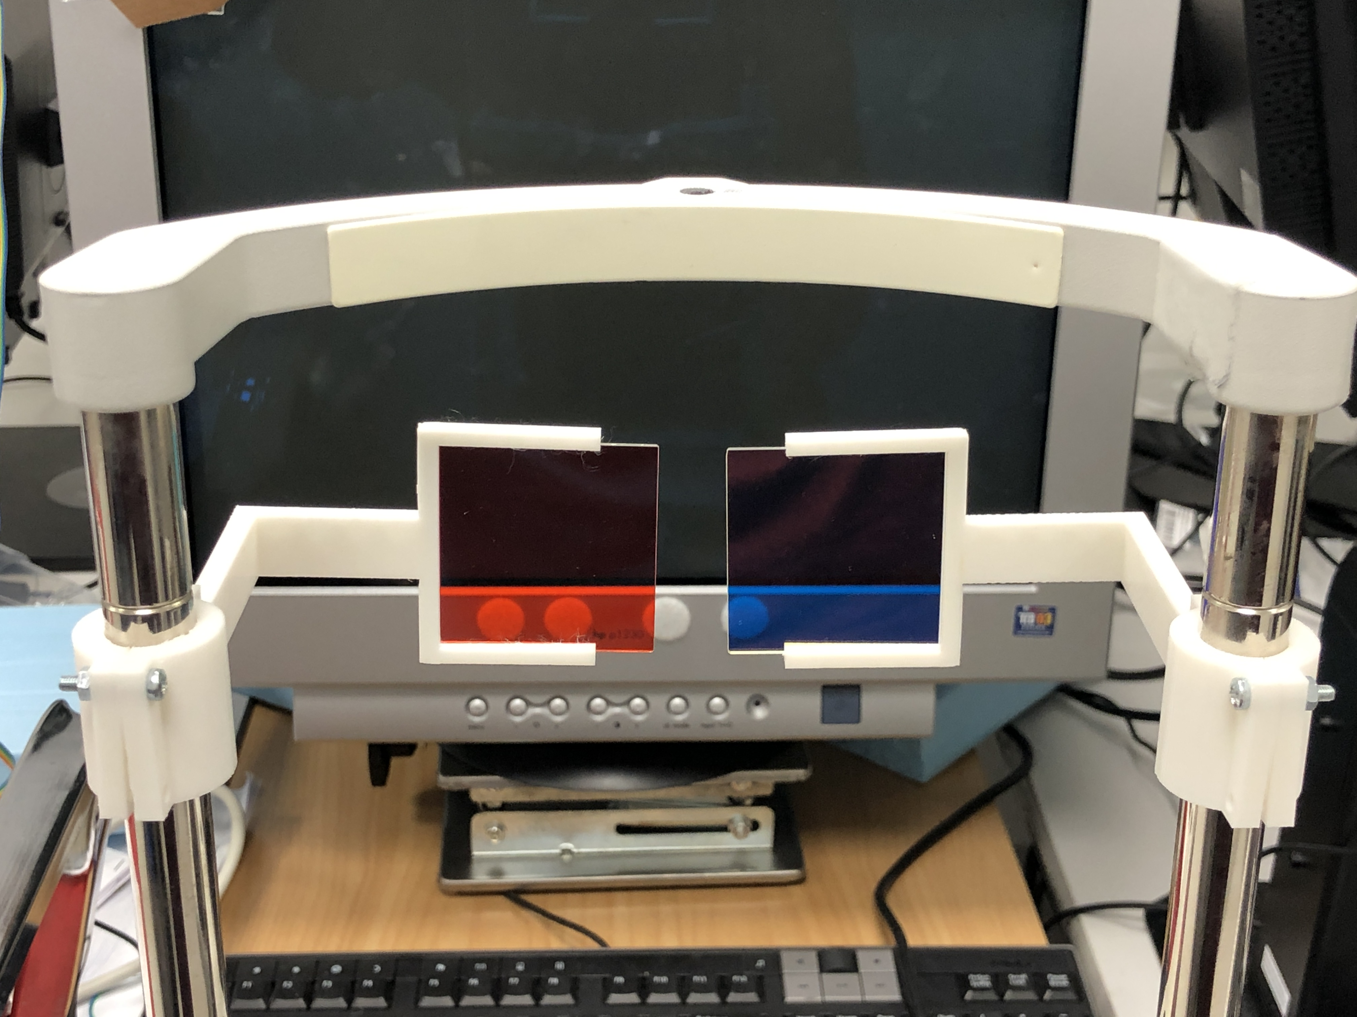
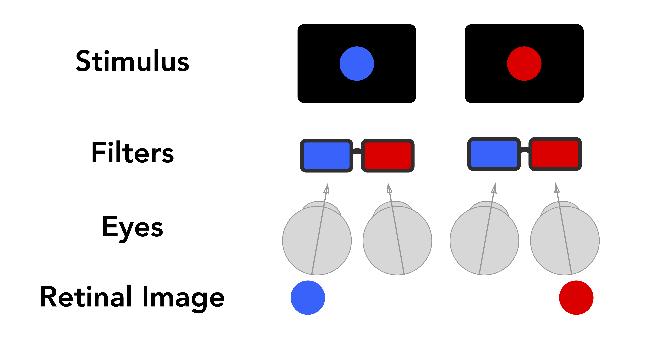
Method
Visual Stimuli
Eight visually normal subjects viewed red or blue visual stimuli
Using red/blue filters with red/blue targets, subject’s eyes were stimulated individually (dichoptic stimulation)

Slide 6

METHOD
Fixation Test
Nine red or blue circular fixation targets appeared at different locations on the monitor
At each location, the colour of the fixation target alternated between blue and red at a frequency of 1 Hz

Slide 7

METHOD
Tracking Test
A single red or blue target moved back and forth along the horizontal or vertical meridians repeatedly
The trajectories were slow (<10 deg/s) to allow for measurements of smooth pursuit eye movements (without corrective saccades)
Notes:
- Change horizontal/vertical position over time is driven by a sinusoid

Slide 8
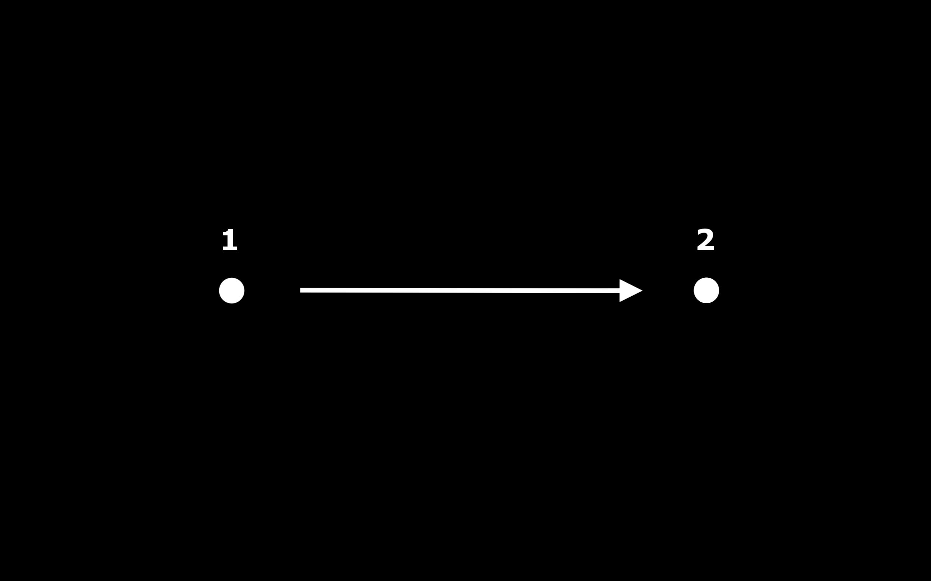
METHOD
Calibration
4-point calibration for fixation test
2-point calibration for tracking tests (horizontal and vertical)
Enable measurements of gaze position relative to screen-space for analysis
2
1
1
2

Slide 9
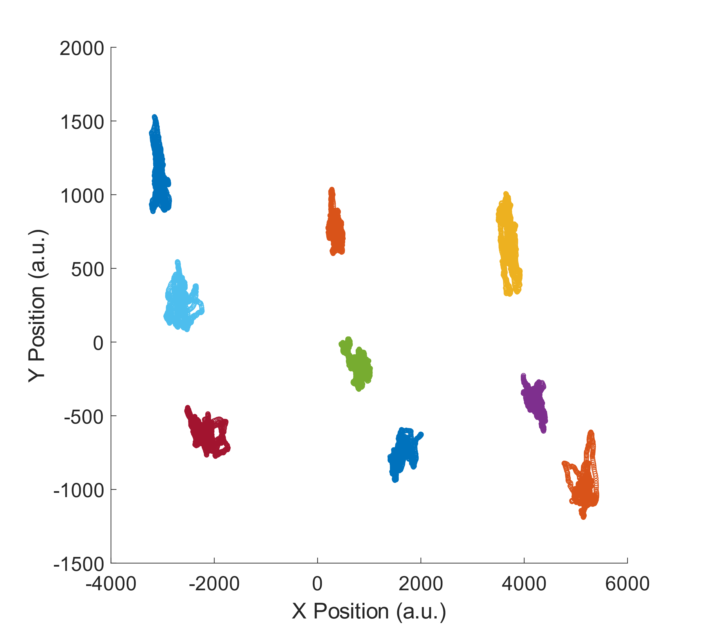
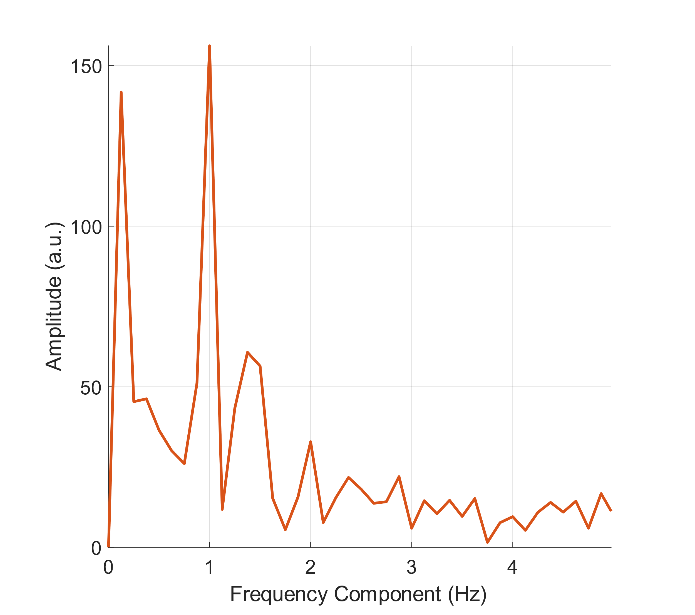
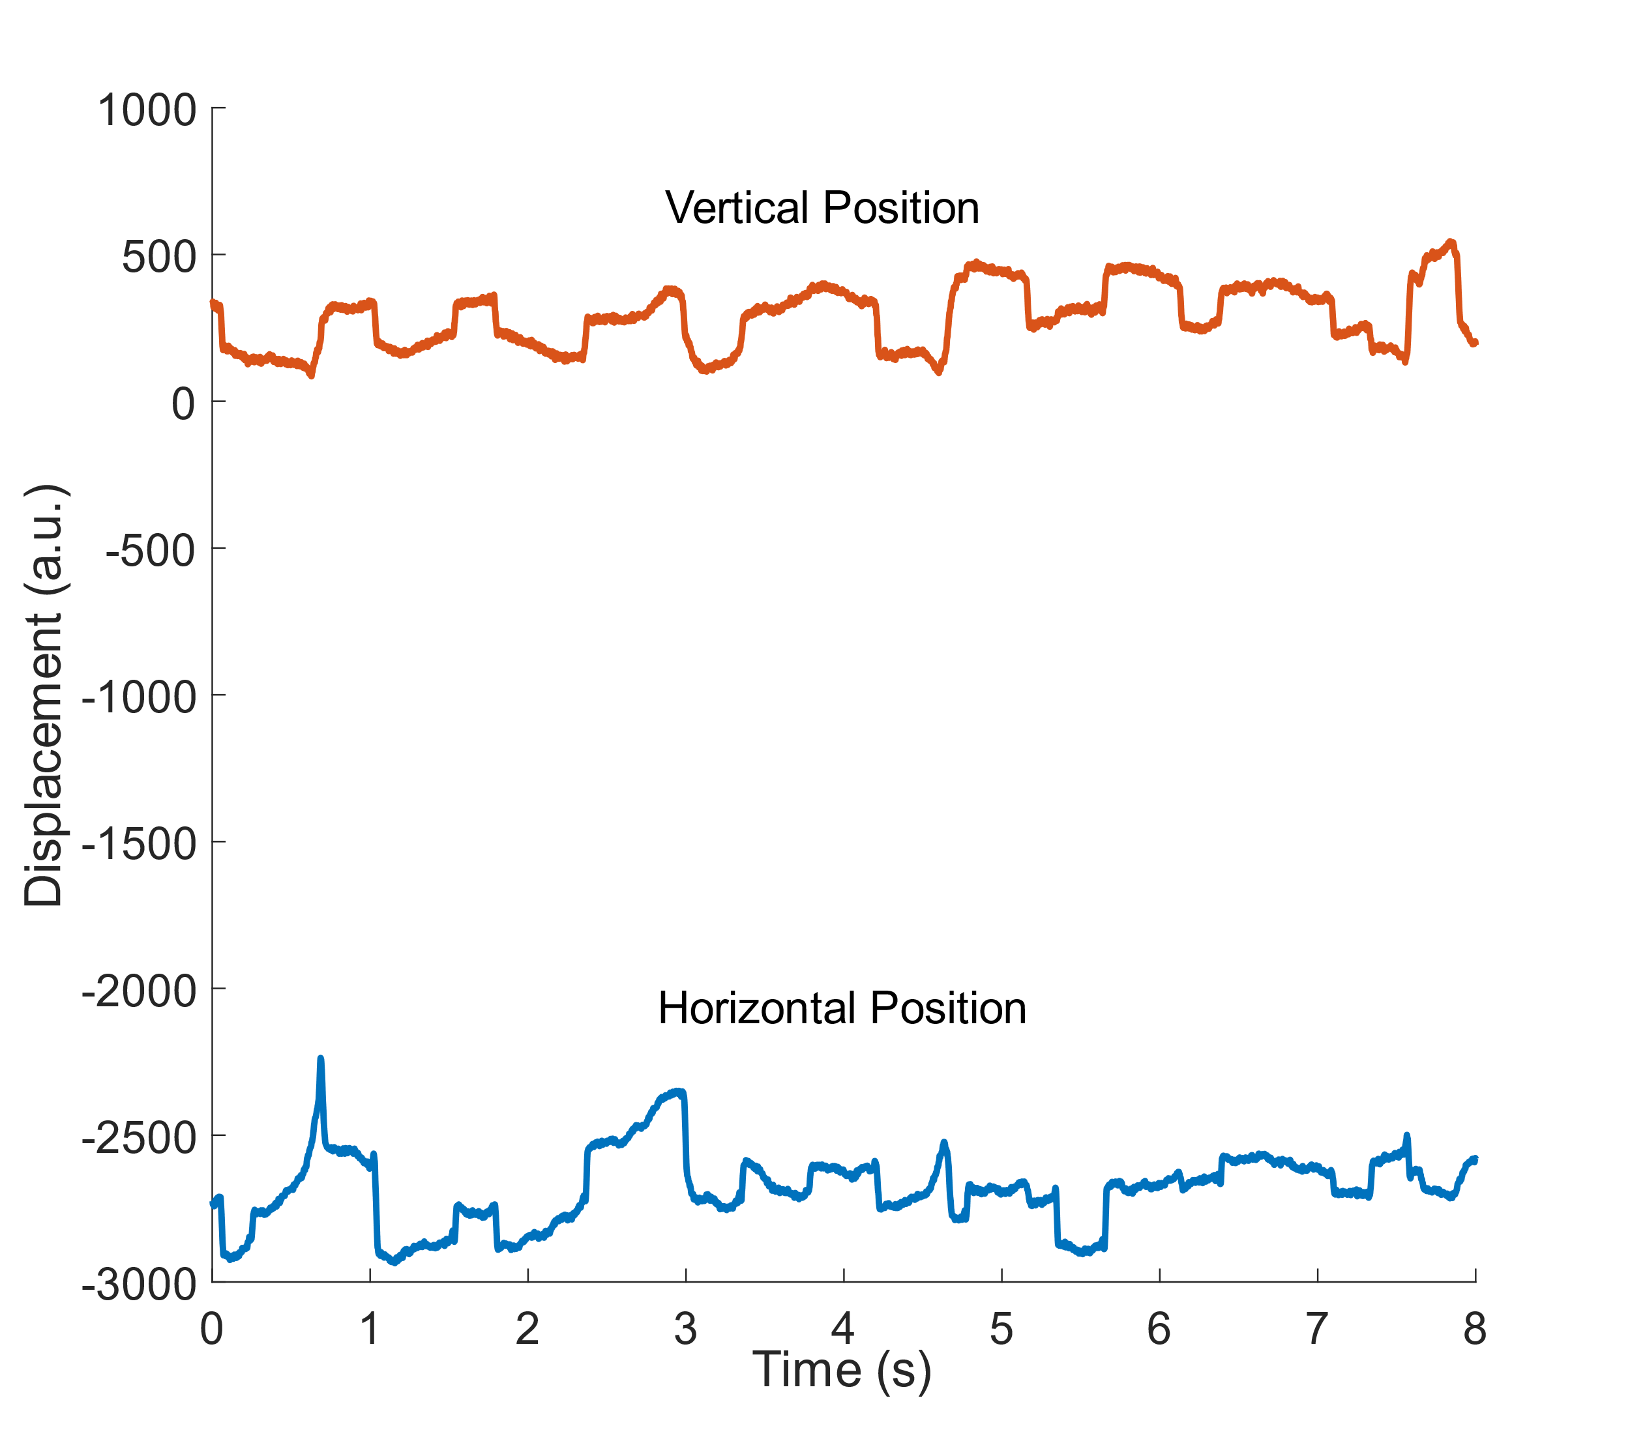
Results
Fixation Test – Subject A
Horizontal and vertical gaze responses were plotted against each other for an overview of all nine fixation points.
Fast Fourier Transform (FFT) of the gaze response at fixation point 6 indicates presence of large oscillations at 1 Hz
Notes:
- Discuss horizontal and vertical deviation values and accuracy

Slide 10
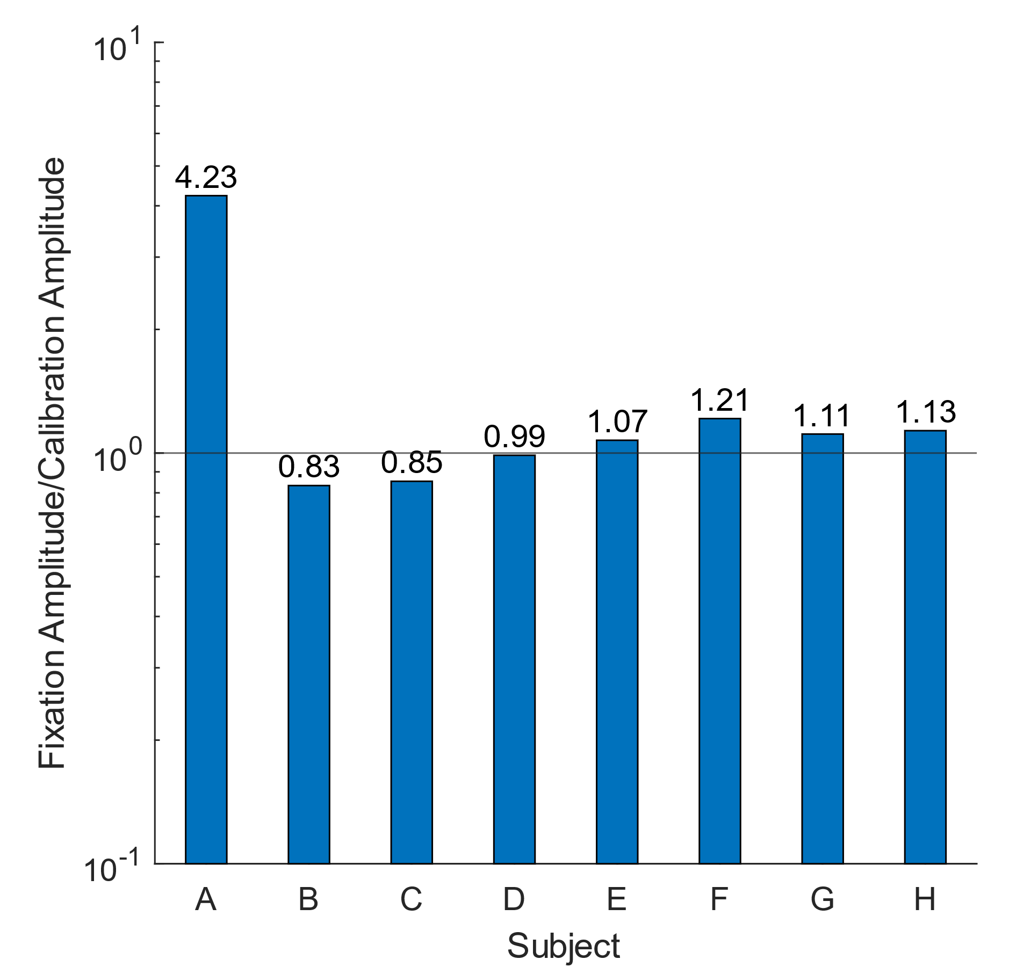
Results
Fixation Test – Group
Other subjects did not display significant oscillations when fixating
Fixation test provided adequate sensitivity for the detection of deviations in both visual axes
We would expect strabismic subjects to exhibit larger amplitudes/deviations

Slide 11
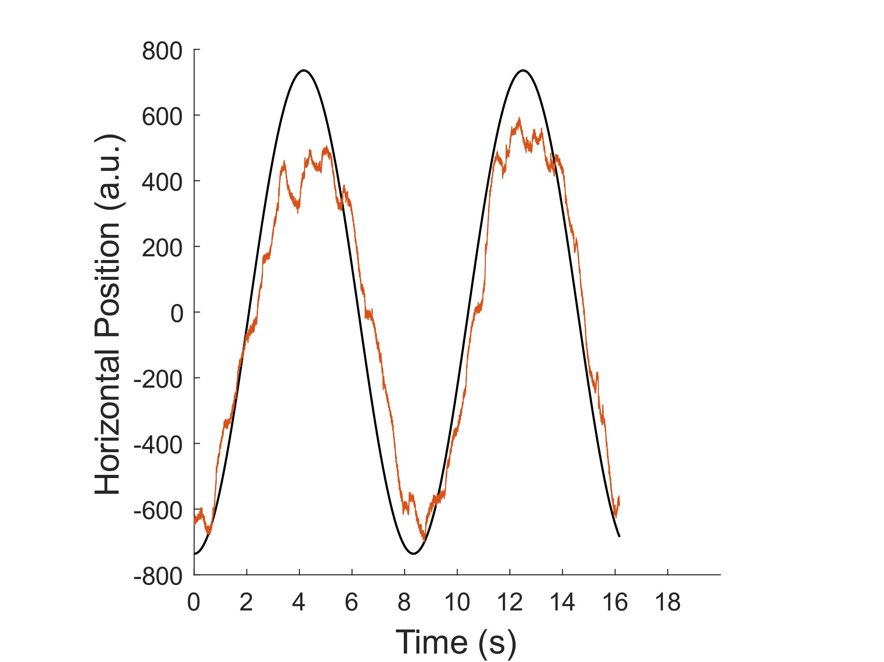
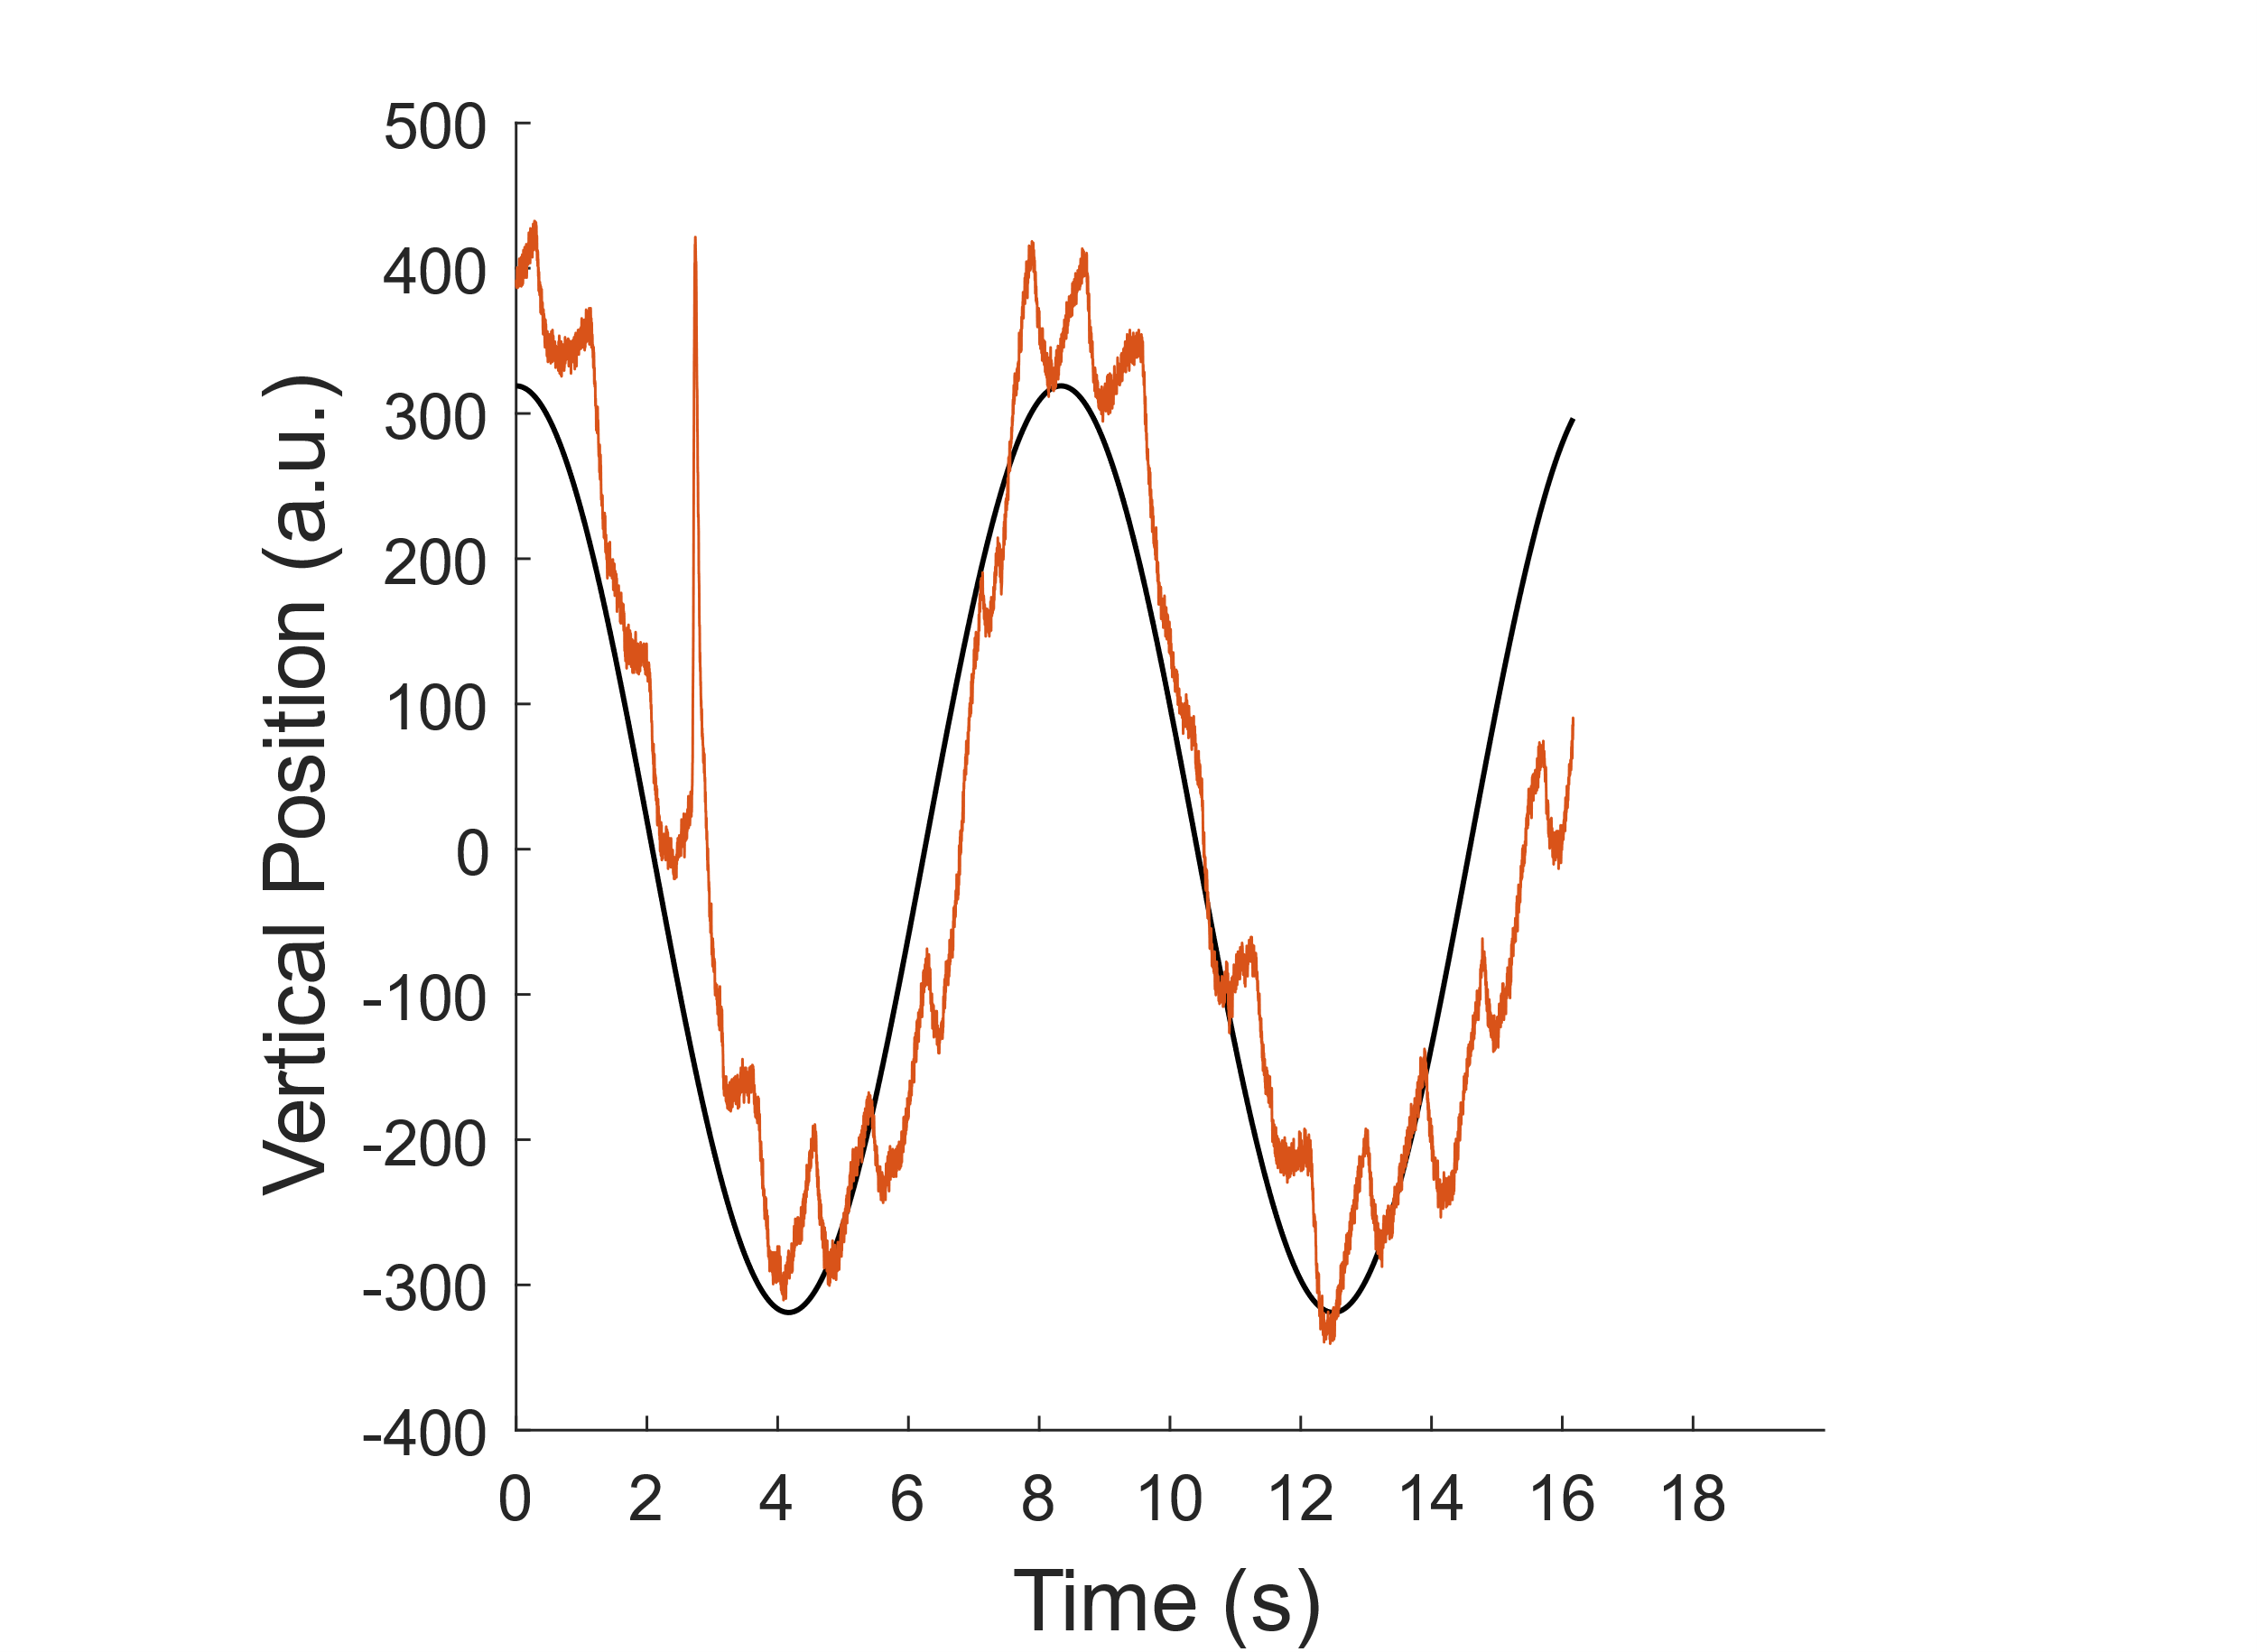
Results
Tracking Test – Subject B
Gaze response was compared against the stimulus trajectory by measures of gain and phase lag
Non-dominant eye exhibited more phase lag and lower gains than dominant eye

Slide 12
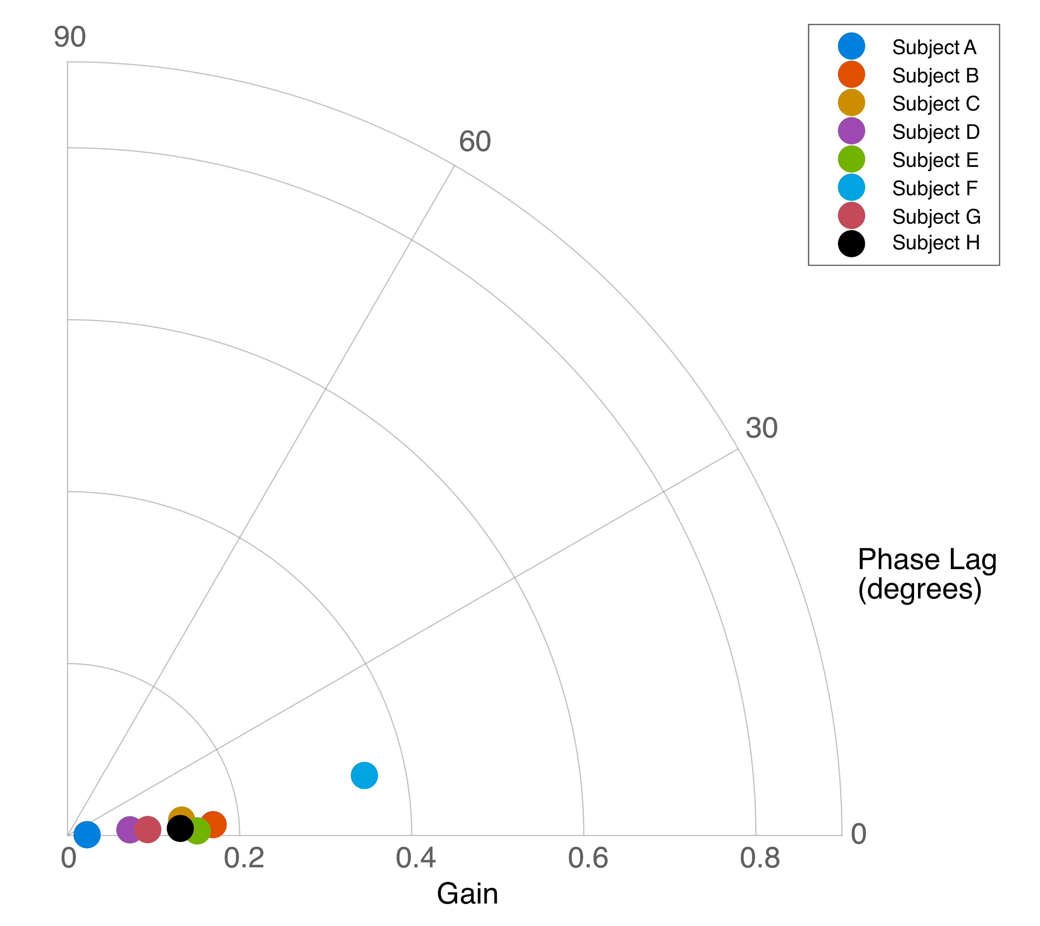
Results
Tracking Test – Group
Other subjects displayed gain near unity and phase lags that were similar between both eyes
Between-eye differences in tracking performance can be measured
The gain and phase differences may be indicative of the affects in tracking performance from ocular deviations. Further investigation is needed

Slide 13
Conclusion
Fixation and tracking tests allowed quantitative and objective examination of eyes
Dichoptic stimulation successfully enabled the analysis of gaze response for each eye individually.
Eye-tracking system can provide enough sensitivity to acquire between-eye differences in strabismic patients.
Tests have the potential to be used in children, as an alternative to manual examinations.

Slide 14
Future work
Further Testing of Subjects
Acquire strabismic subjects’ data for comparison
Further testing of visually normal subjects for validity
Automated analysis via Machine Learning
Classify type of strabismus autonomously using training data
Mobile System
Non-contact eye-tracker suitable for children
Ability to use in clinical practices on the go (i.e Tablet)

